Slide 1


Working with the Railroad
Darren Eyre
Principal Rail Services
Clint Allen
Rail Practice Lead

Slide 2
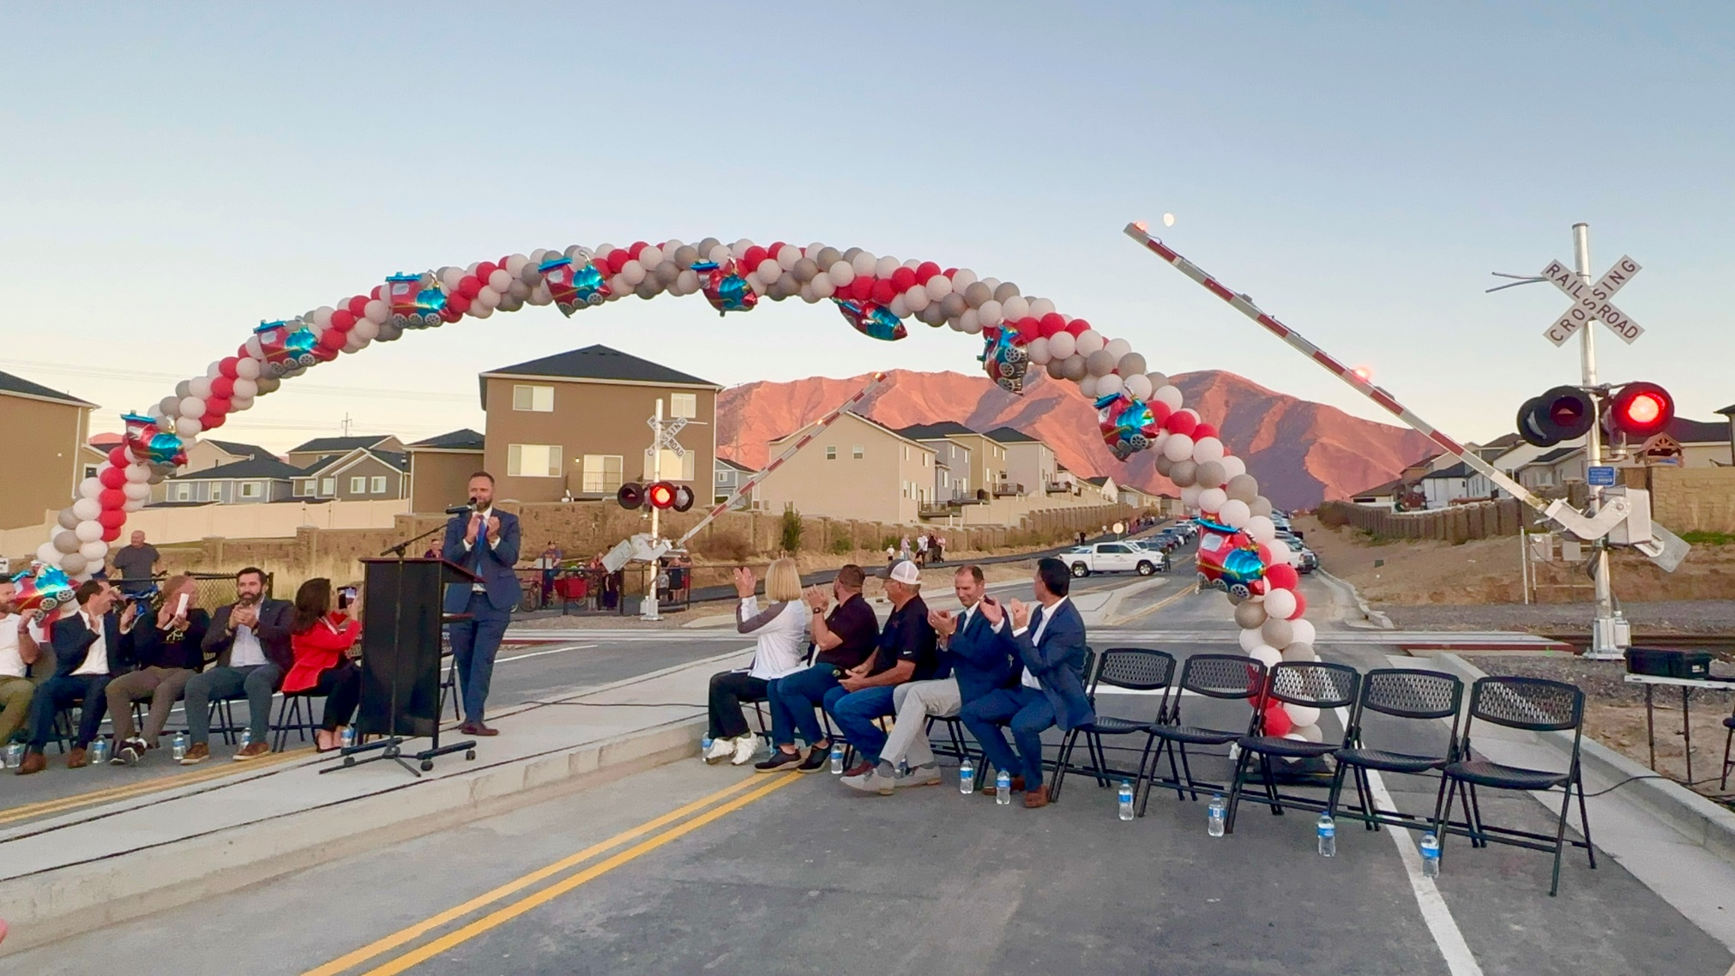
How to Successfully Work with the Railroad

Slide 3


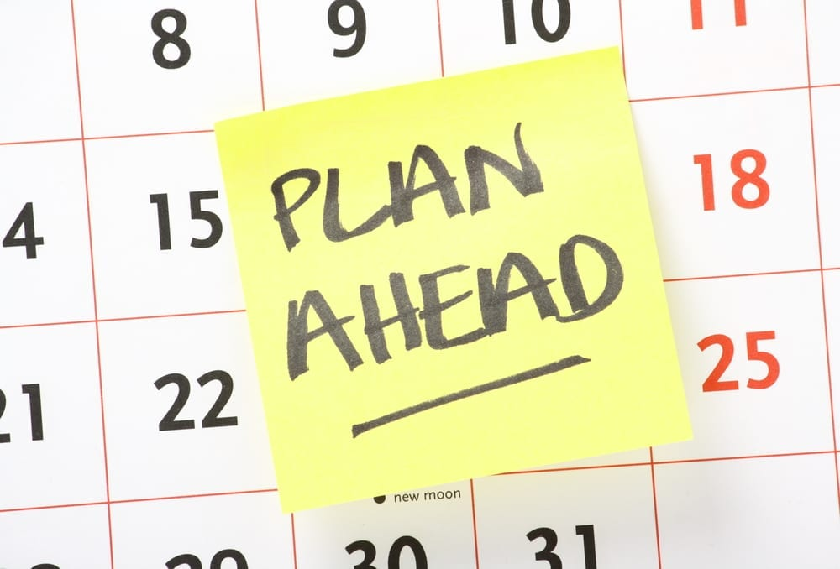
How Long does a Railroad Project Take?

Slide 4


How to Speed up a Railroad Project?

Slide 5
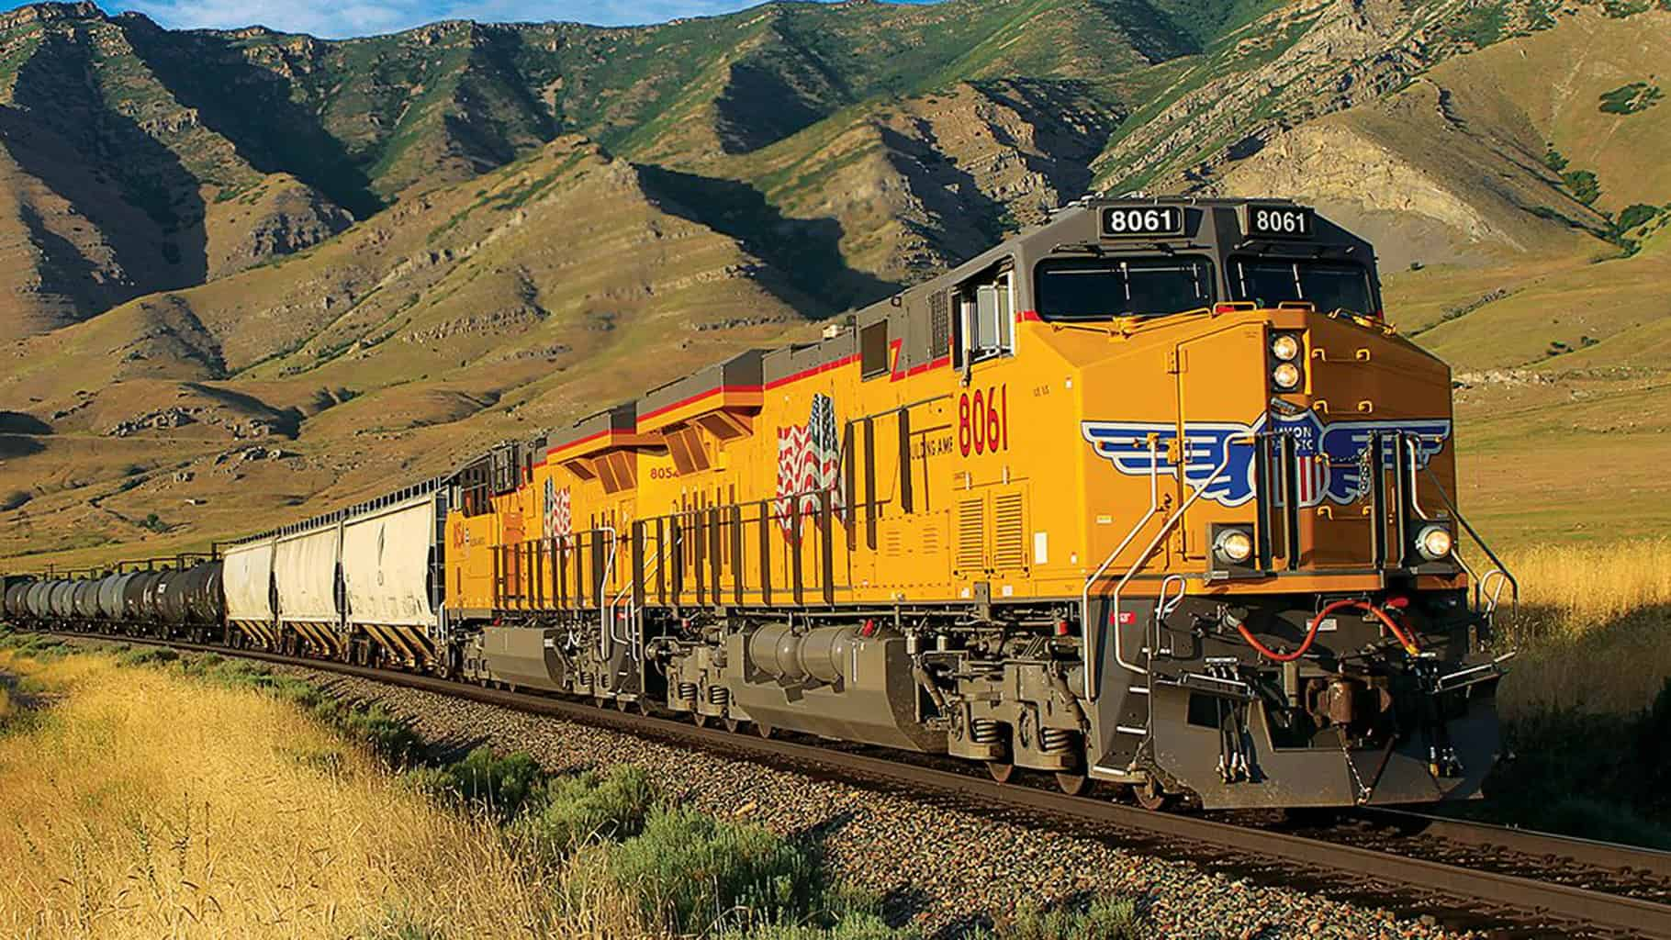
Learning Objectives
PE / RA Agreement
Right of Entry Permit
Flagger Protection
ROW Maps
At-Grade Railroad Crossings
Grade Separated Crossings
Maintenance Consent Letter
Railroad Perspective and Operations
Utility Crossing or Encroachment
Drainage Modification
Property Sales and Leases
Quiet Zones
Notes:
Nick: Gray
Kohl: Navy
Clint: Orange

Slide 6

Presentation Slides

Slide 7





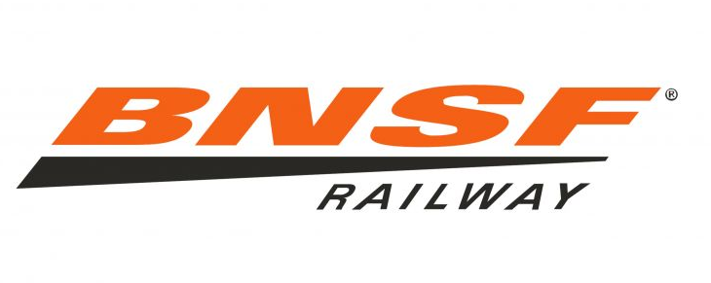
Railroad Company Objectives and Perspective
Passenger / Transit – Safely move as many people as efficient as possible
Freight – Safely move as much freight as efficient as possible
Historical – Give the public an experience riding a train
All railroad companies have financial objectives in addition to safety and efficiency.

Slide 8
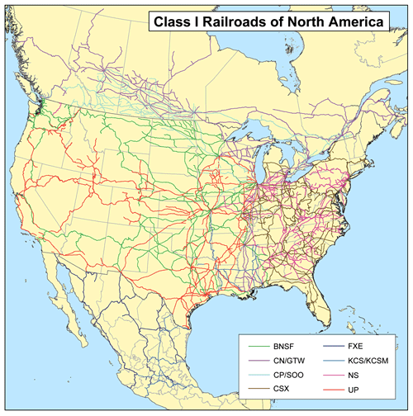
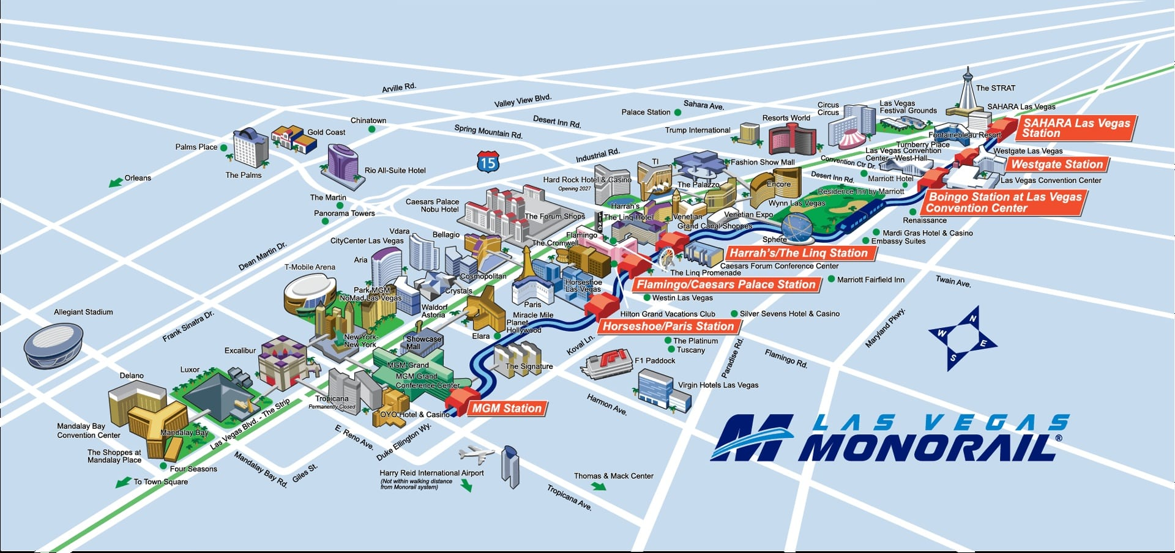
Railroad Company Objectives and Perspective

Slide 9
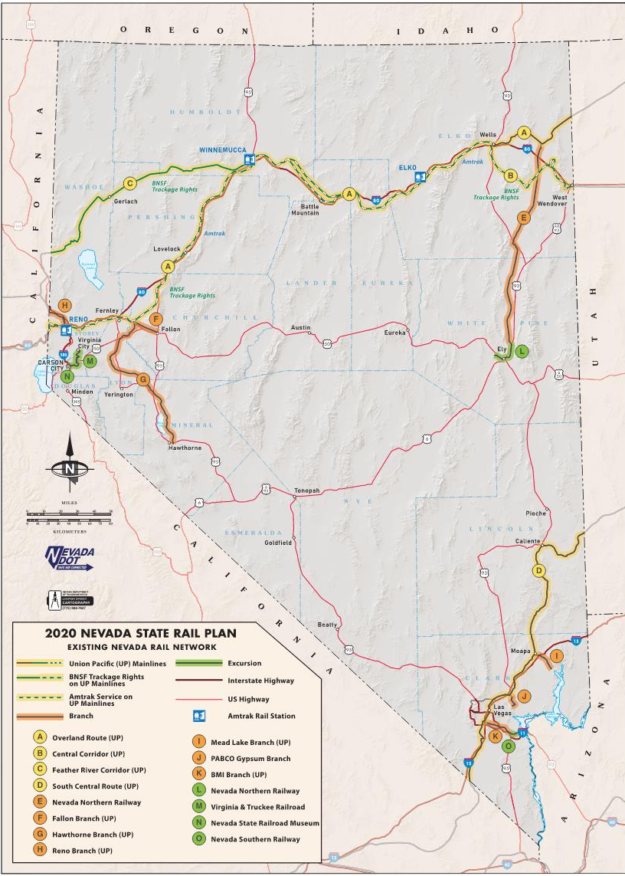
Railroad Company
Objectives and Perspective

Slide 10
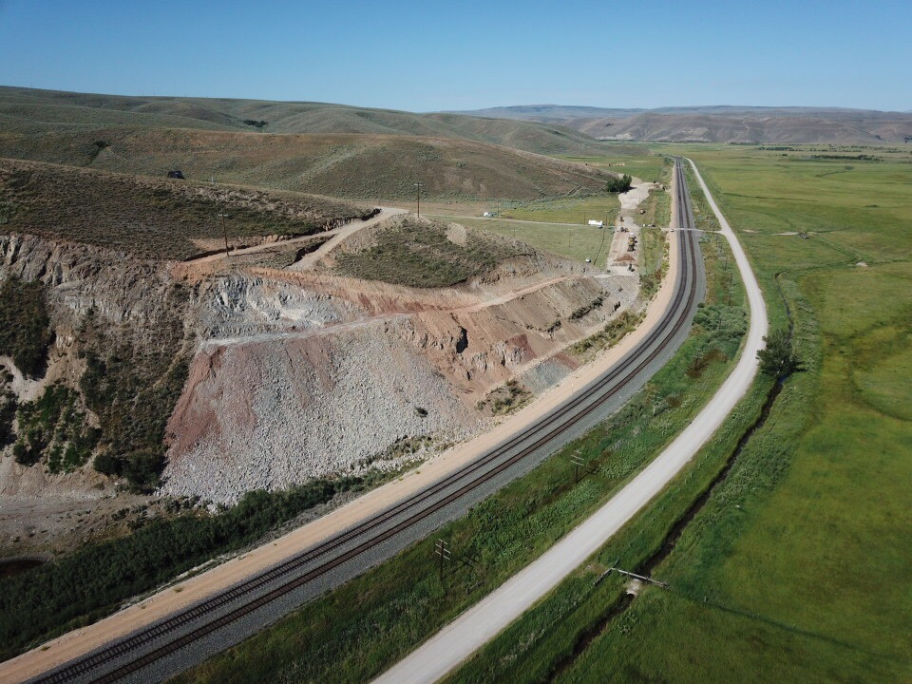
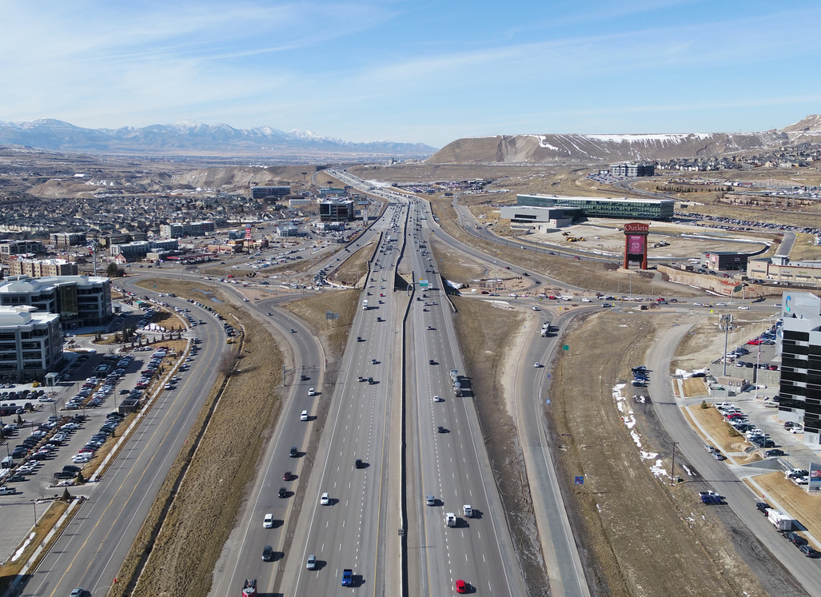

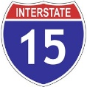
Railroad Operations
Railroad Mainline
=
Road Authority Interstate

Slide 11
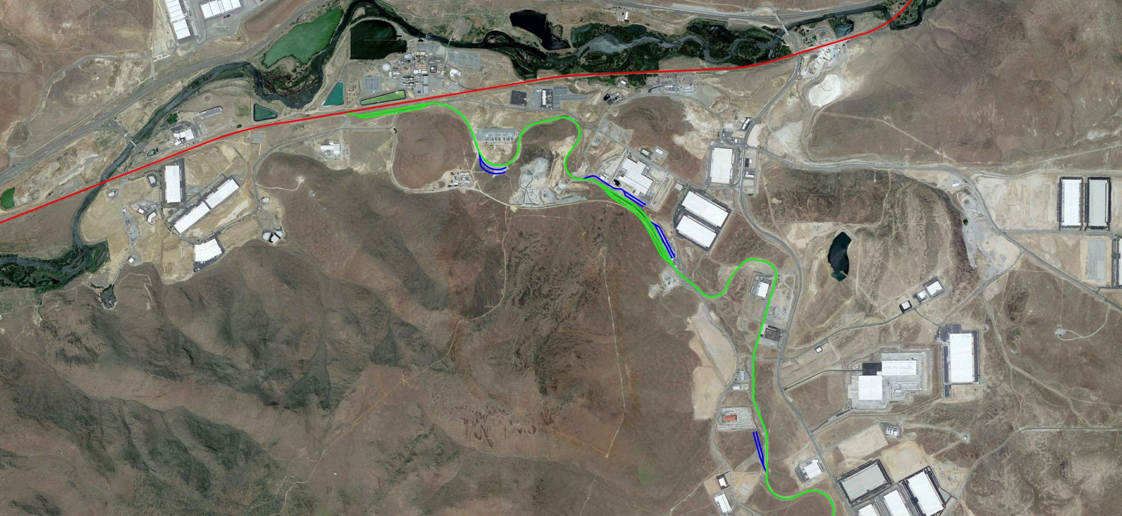
Railroad Operations
Mainline
Runaround Track
Industrial Lead
Interchange Yard
Industry Spurs

Slide 12
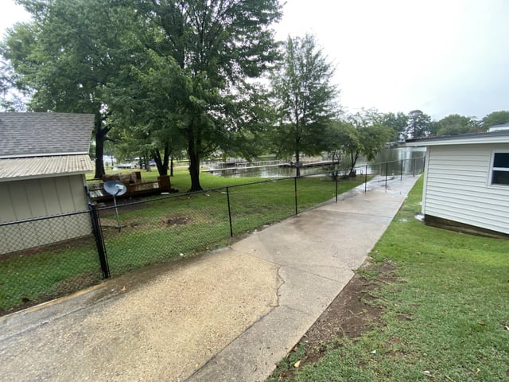
Building Across Your Neighbors Property
Railroads are private landowners and require similar considerations when crossing their property.

Slide 13
PE / RA Agreement
UP requires PE agreements for their participation on public projects
Relevant standards and resources:
  UP Contact Center https://benesch.quickbase.com/db/bpqhu6hqy?a=dbpage&pageid=13
  FRA Inventory https://fragis.fra.dot.gov/gisfrasafety/
Process / timeline: 2 weeks – 2 months
Contacts:
  UP – Rooke Jackson - RJackson@benesch.com

Slide 14
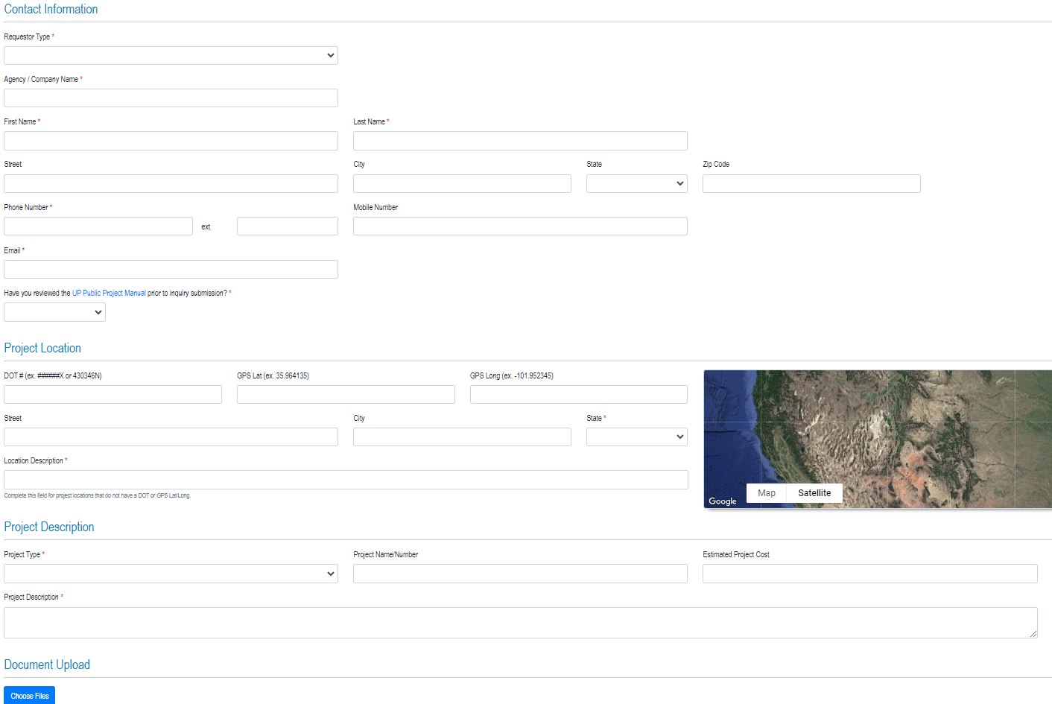
PE / RA Agreement

Slide 15
PE / RA Agreement

Slide 16
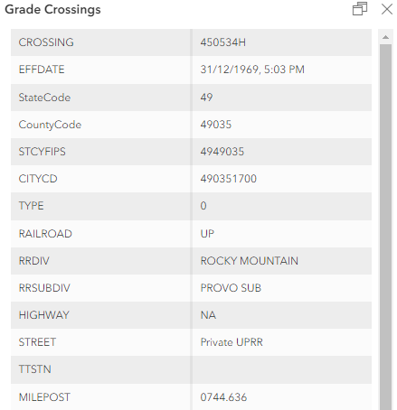
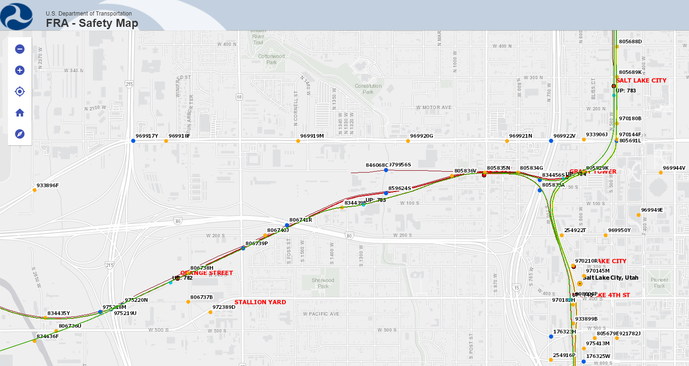
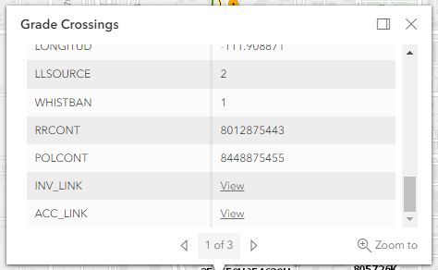
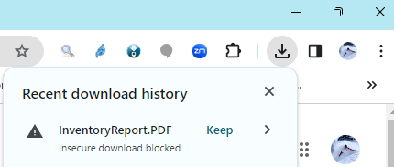
PE / RA Agreement

Slide 17
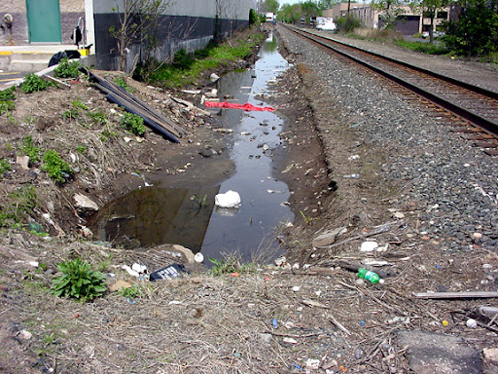
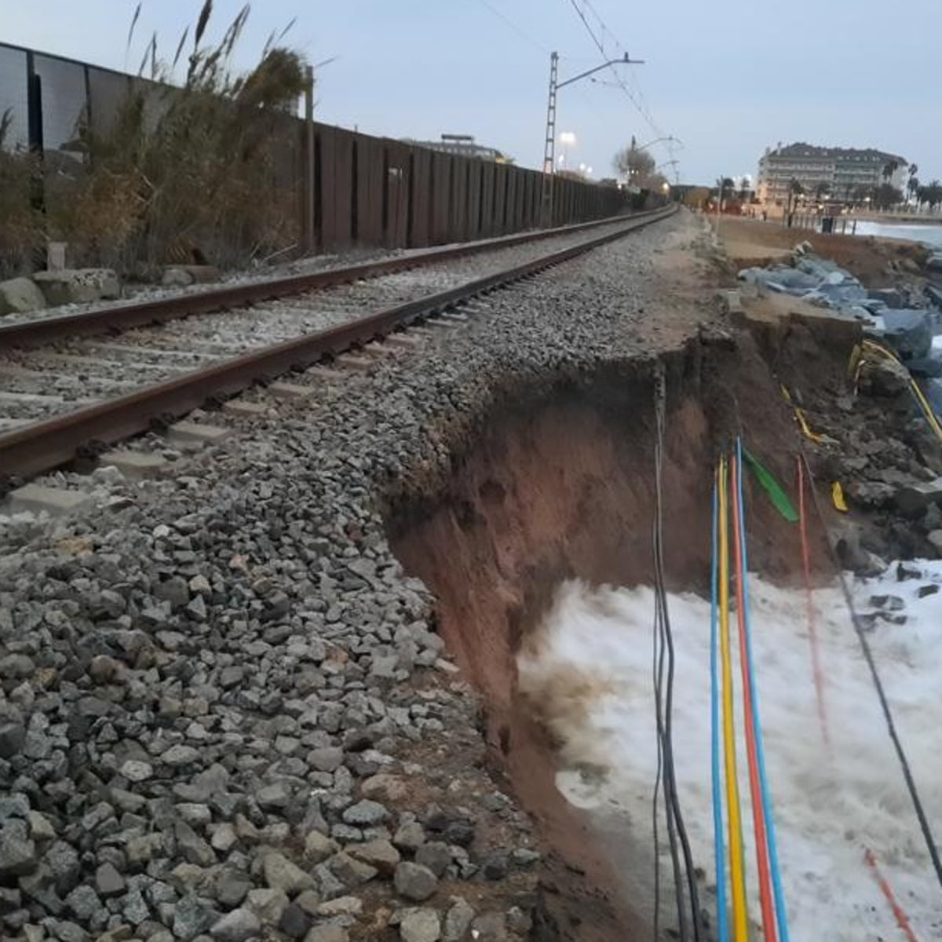
Drainage Modification

Slide 18

Drainage Modification
Relevant standards and resources:
  Drainage modification procedures https://www.up.com/real_estate/drainage/procedure/index.htm
  Drainage and Waterway Encroachment Planning Guide & Construction Procedures https://www.up.com/real_estate/drainage/encroachment/index.htm
  Drainage and Waterway Hydrology Study Guide https://www.up.com/real_estate/drainage/hydroguide/index.htm
  Permit To Be On Railroad Property for Utility Survey https://www.up.com/cs/groups/public/@uprr/@realestate/documents/up_pdf_nativedocs/pdf_up_reus_rrpermit.pdf
  Online drainage application https://www.uprr.com/rem/ucs/jas/#/home

Slide 19

Drainage Modification
Timeline after submittal (3-6 months)
Cost ($3,055)
Noteworthy items from experience:
  Write a memo explaining what you are doing, why, and how it benefits the railroad
  Stay out of shoring zone
  Prepare full H&H study – 50-year storm event minimum
  Show drainage arrows on plan view sheets
  Show 50 and 100-year HGL’s on profile sheets
  Show ROW limits w/ dimensions to proposed modifications
  Don’t overtop subgrade (3’ below top of rail)

Slide 20
Property Sales and Leases
Relevant standards and resources:
  Property sales overview https://www.up.com/real_estate/PropertySales/index.htm
  Verify real estate manager https://www.uprr.com/reus/contacts/mgrcontacts/index.cfm
  Property sale application https://www.up.com/cs/groups/public/@uprr/@realestate/documents/up_pdf_nativedocs/cdf_up_property_sale_app.pdf
  Property lease application https://www.up.com/cs/groups/public/@uprr/@realestate/documents/up_pdf_nativedocs/pdf_up_property_lease_app.pdf

Slide 21
Property Sales and Leases
Timeline after submittal
  3-12 months
Cost
  Usually more than your appraised value (increased cost due to corridor factor)
  $50,000 minimum sale price
Noteworthy items from experience:
  Obtain a survey w/ title report
  Obtain an appraisal
  Be patient

Slide 22
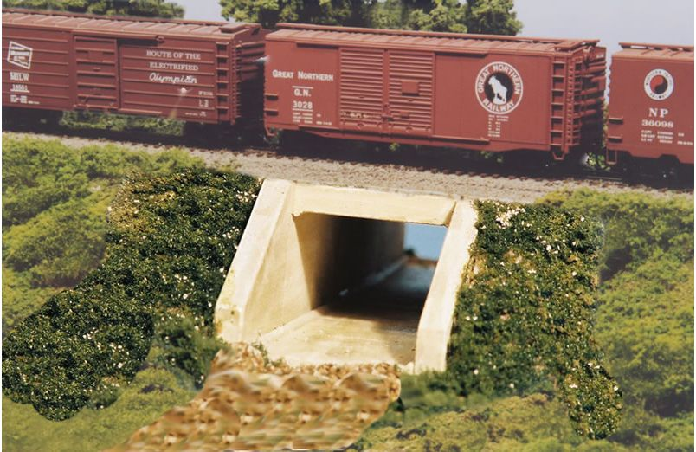
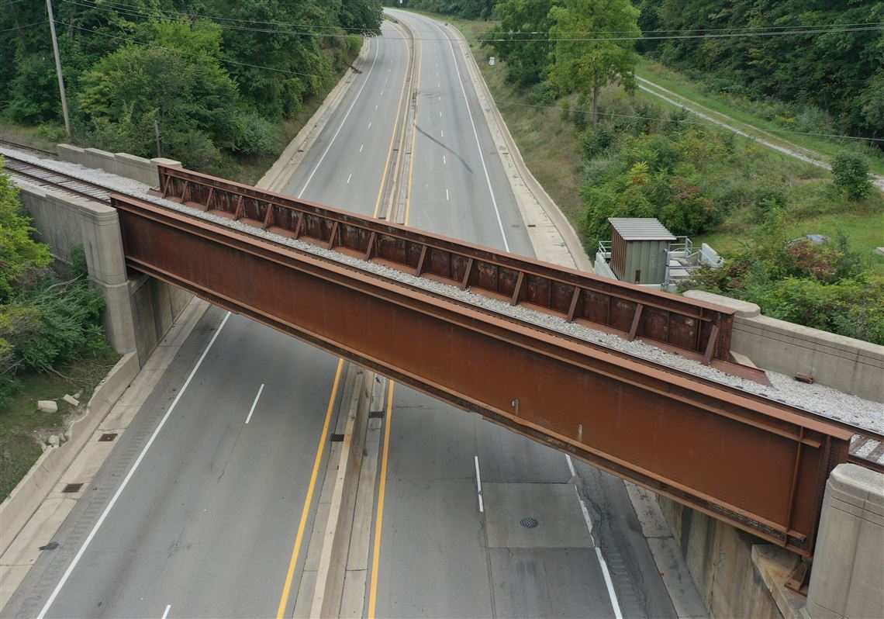
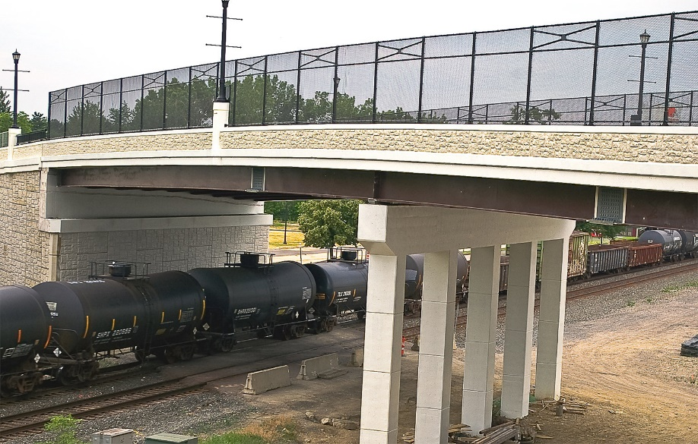
Grade Separated Crossings

Slide 23
Grade Separated Crossings
Relevant standards and resources:
  UP / BNSF Guidelines for Railroad Grade Separation Projects, Shoring Guidelines, Demolition Guidelines https://www.up.com/real_estate/roadxing/industry/grade_separation/index.htm
  AREMA Manual for Railway Engineering ($1,000 - $1,500) https://publications.arema.org/Publication/MRE_2023
  UP Public Projects Manual https://www.up.com/cs/groups/public/@uprr/@corprel/documents/up_pdf_nativedocs/pdf_up_public_projects_manual.pdf
  UP Contact Center https://benesch.quickbase.com/db/bpqhu6hqy?a=dbpage&pageid=13

Slide 24
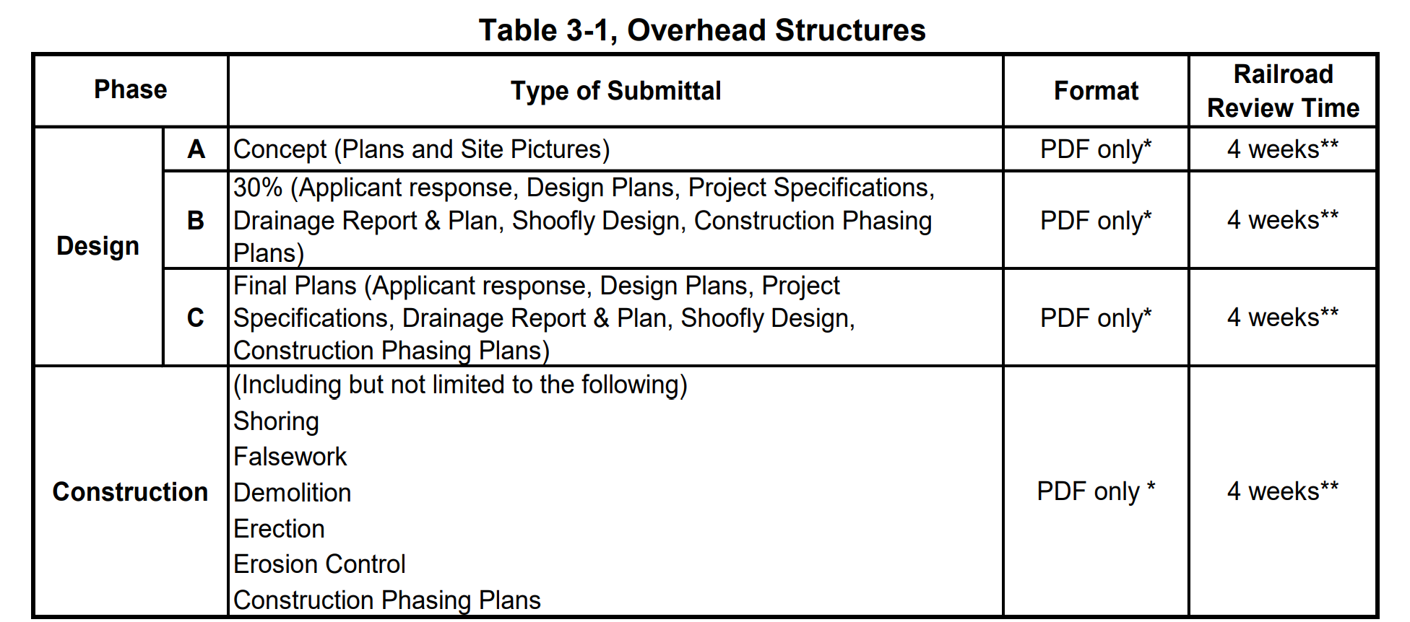
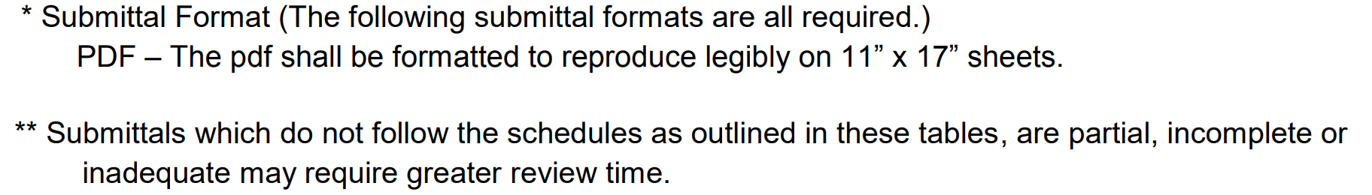
Grade Separated Crossings

Slide 25
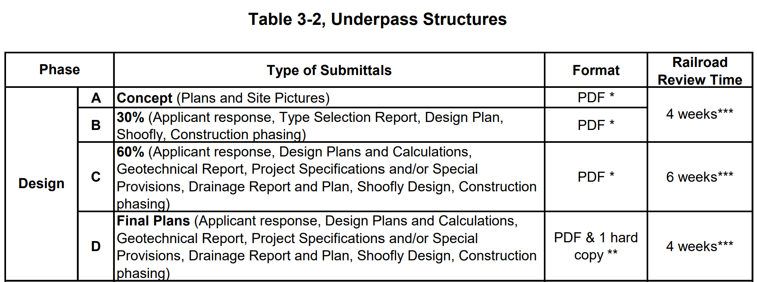
Grade Separated Crossings

Slide 26
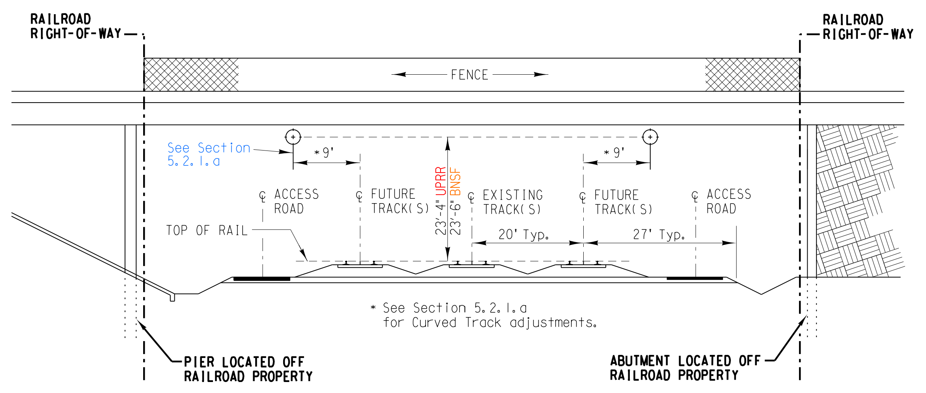
Grade Separated Crossings

Slide 27
Grade Separated Crossings
Noteworthy items from experience:
  Clear span the entire ROW
  Meet vertical clearance from top of rail @ future track + 9 feet
  Plan for future rail, access road, and drainage ditches
  Fences are needed even if there is not a pedestrian pathway on road
  Lighting needed for bridge widths covering more than 80’ of rail length
  Settlement and monitoring plan (report at 1/8”, stop work at 1/4”)
  Must have a construction phasing plan w/ crane storage area
  Ditch shown on previous exhibit is not to scale (10’ bottom width, 2:1 side slopes, 3’ deep OR do a drainage study showing smaller works)
  Rail bridges should accommodate a future track and access road
  Construction clearance envelope (21.5’ vertical, 15’ horizontal)
  Removed pillars to be cut 3’ below grade

Slide 28
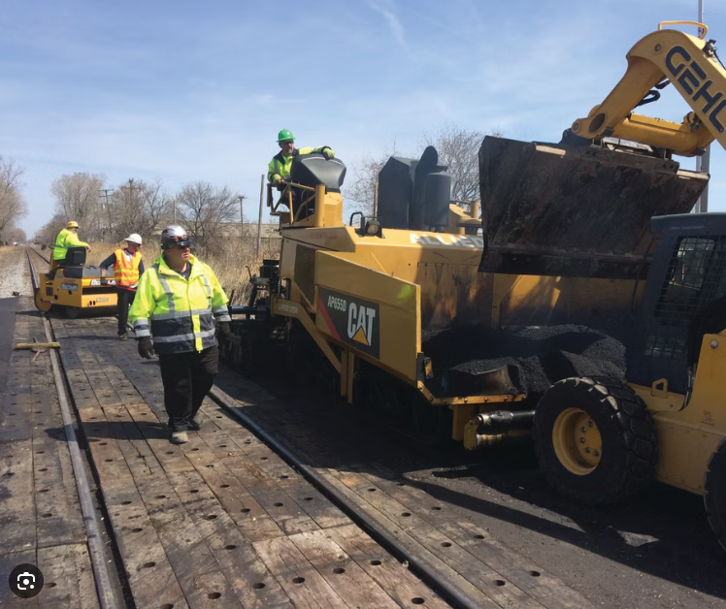
Maintenance Consent Letter
Paving mill and overlay
Existing Sidewalk repairs
Existing fence repairs
Lighting
Bridge inspection
Roadway / Bridge minor repairs
  Barrier rail or fencing replacement, deck seal-coating, deck or pier spall repairs
Culvert and ditch cleaning

Slide 29
Maintenance Consent Letter
Relevant standards and resources:
  UP Public Projects Manual https://www.up.com/cs/groups/public/@uprr/@corprel/documents/up_pdf_nativedocs/pdf_up_public_projects_manual.pdf
  UP Contact Center https://benesch.quickbase.com/db/bpqhu6hqy?a=dbpage&pageid=13
Timeline after submittal
  4-8 weeks (must already have C&M agreement in place)
Cost
  Varies
    Simple: $2,200 application fee
    Complex: PE Agreement Cost: $5,000 - $25,000
  What is a complex MCL?
    Usually anything that requires structures review or impacts interconnected crossings.
  Contractor endorsement – similar to a ROE (contractor must have most items similar to a ROE – RPLI, flagging, RWP training, etc.)

Slide 30
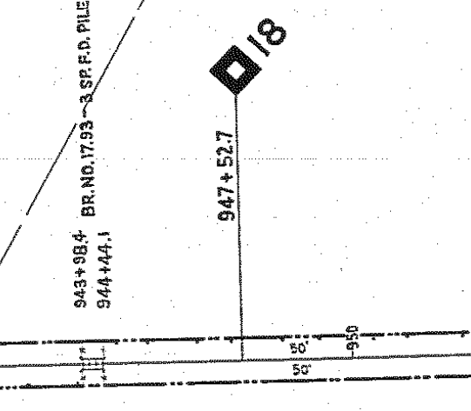

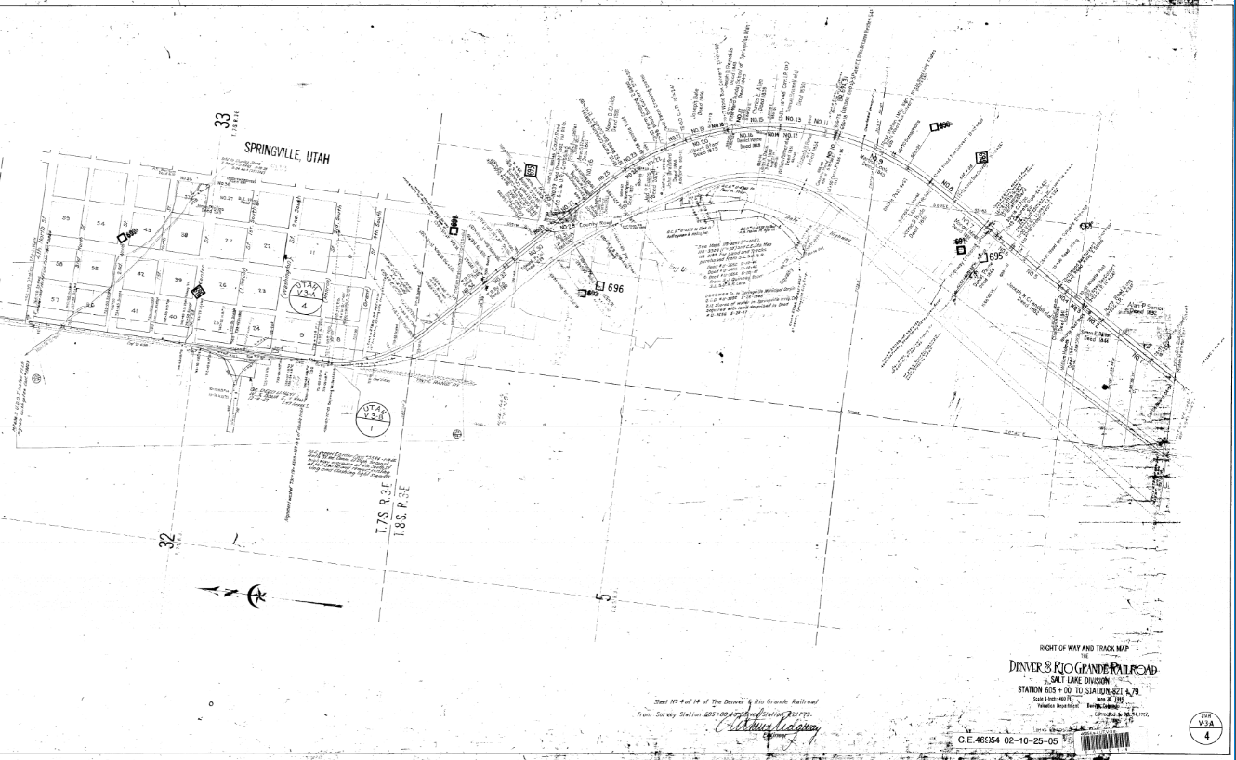
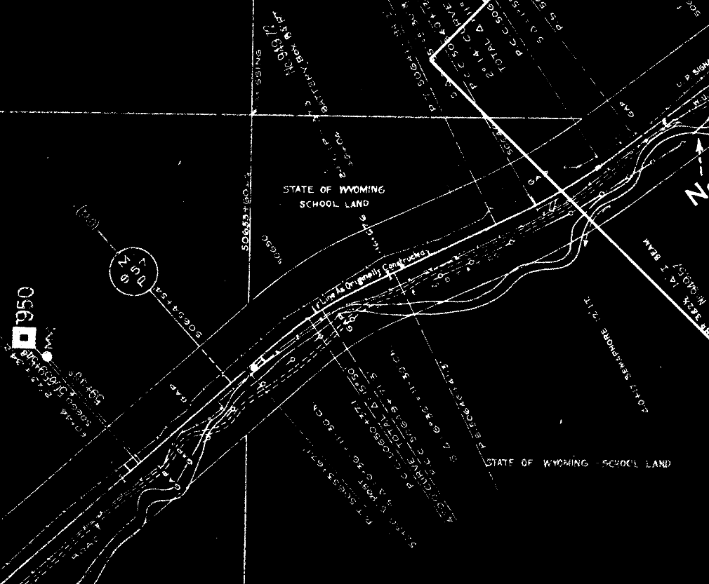
Right of Way Maps
MP MARKER
OFFSET DISTANCES

Slide 31
Right of Way Maps
UP map librarian https://www.up.com/real_estate/PropertyOwnership/index.htm
  Public projects staff can also provide you with ROW maps after a PE agreement has been obtained
Shortlines – Obtain a boundary survey and ask property management staff if they have any additional records

Slide 32
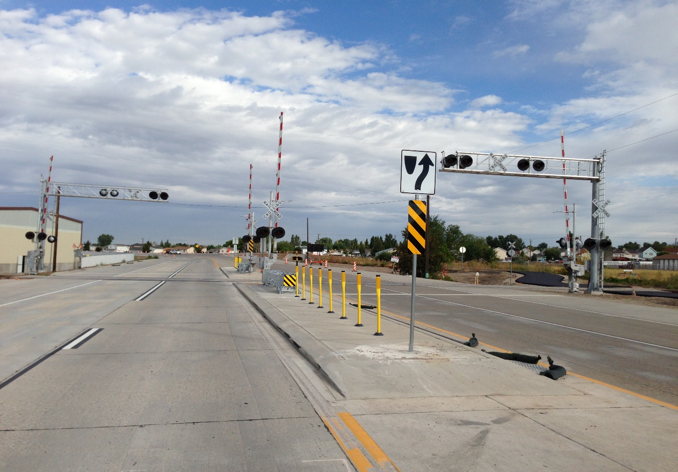
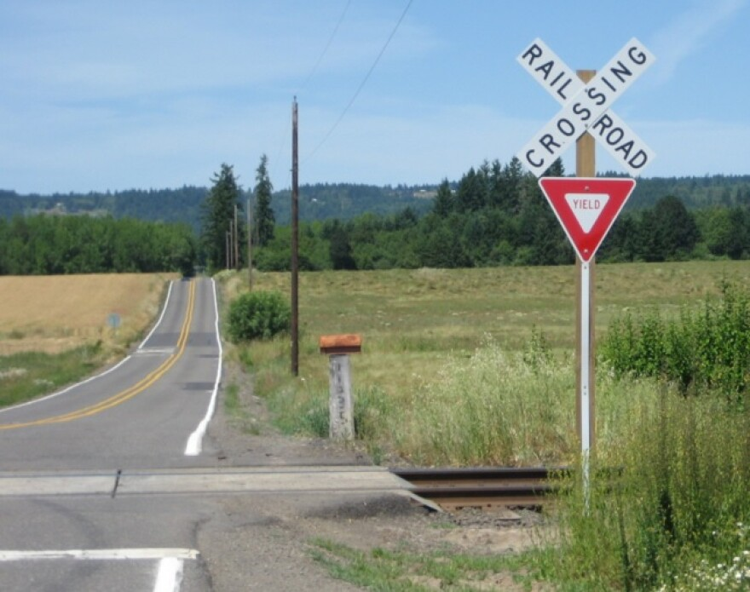
At-Grade Railroad Crossings

Slide 33
At-Grade Railroad Crossings
Relevant standards and resources:
  NDOT standard drawings – RR, SN, and GW sheets dot.nv.gov/home/showpublisheddocument/23088/638702162862070000
  MUTCD Part 8 https://mutcd.fhwa.dot.gov/kno_11th_Edition.htm
  UP public projects manual – released July 2021 https://www.up.com/cs/groups/public/@uprr/@corprel/documents/up_pdf_nativedocs/pdf_up_public_projects_manual.pdf
  AREMA Chapter 5 - Part 8 https://www.arema.org/AREMA_MBRR/AREMAStore/MRE.aspx
  Highway-Rail Crossing Handbook, 3rd Edition https://railroads.dot.gov/gxhandbook

Slide 34
At-Grade Railroad Crossings
Noteworthy items from experience:
  Place signal cabin in passive quadrant, 25’ from nearest rail & 30’ from roadway edge of travel lane, include mountable curb for UP truck access
  UP prefers 5’-3” from signal to face of curb and 9’-3” from signal to edge of traveled way (shortlines will allow 4’-3” and 8’-3”)
  Don’t overlook UDOT’s pedestrian flow chart for the ped xing portion of the roadway crossing
  Plan on 2-3 years minimum to get a new crossing IF you have others to close or increase safety
  FRA requires quiet zones to include 100’ of raised median from the gate arm back (this excludes plowable end sections – UDOT is updating their standards)
  Show a LOT of dimensions for everything on plans

Slide 35
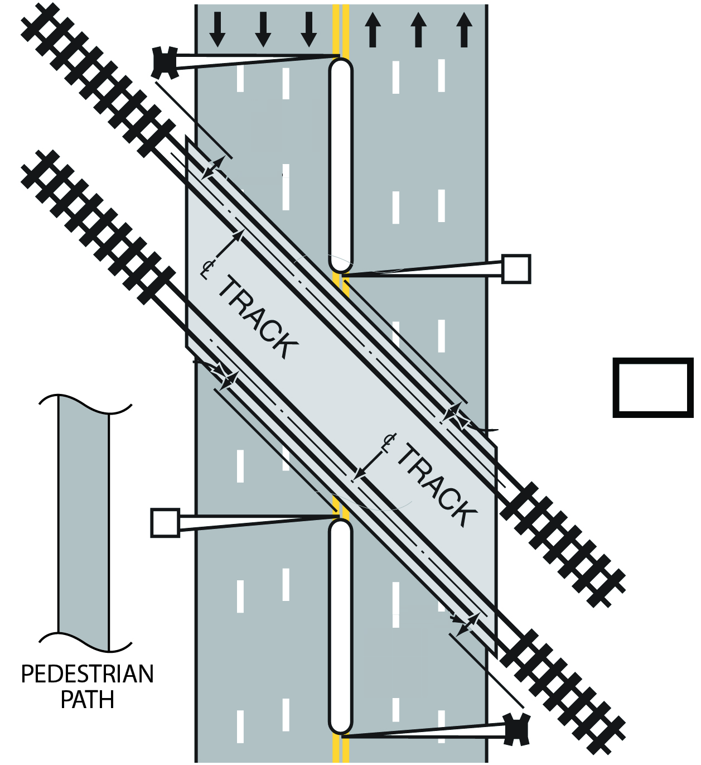
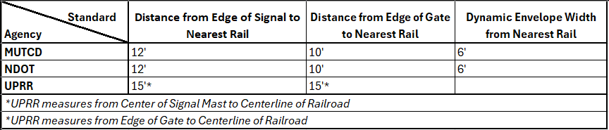
At-Grade Railroad Crossings
  Active Warning Devices
    Lights and gates
    Overhead cantilever w/ flashers
    Stop bar ahead of gates
    Raised Medians

Slide 36
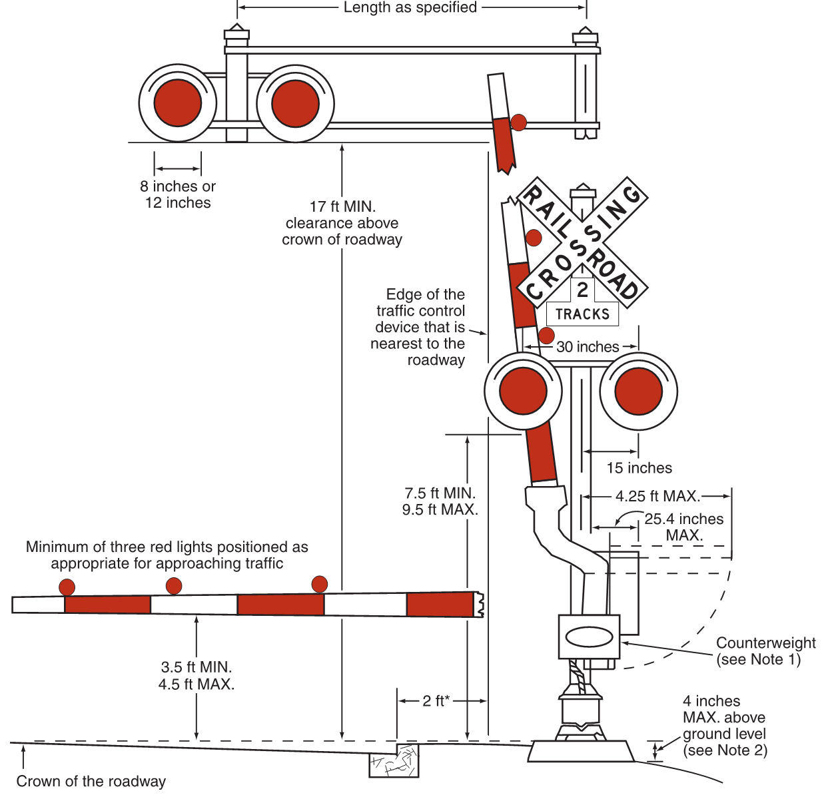
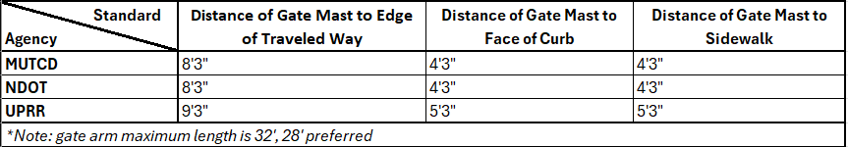
At-Grade Railroad Crossings
  Active Warning Devices
    Lights and gates

Slide 37
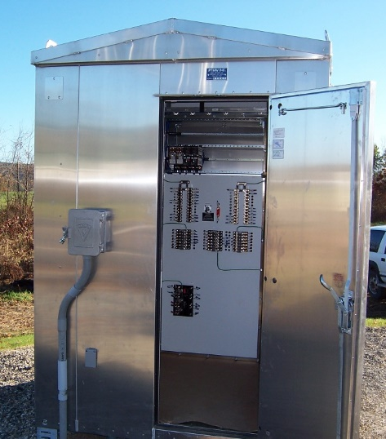
At-Grade Railroad Crossings
  Active Warning Devices
    Signal house / cabin / bungalow
      Passive quadrant preferred
      25’ min from nearest rail (not CL)
      30’ min from edge of traveled way
      UP prefers access pad
      (sometimes w/ curb cut or gate)

Slide 38
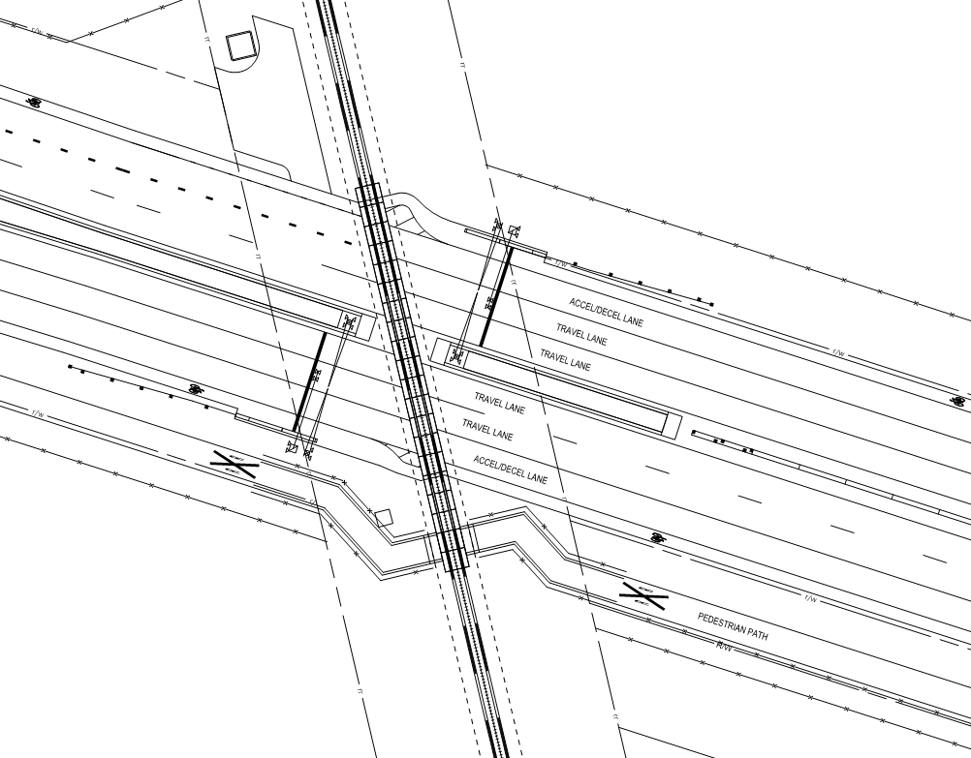
At-Grade Railroad Crossings
  Active Warning Devices
    Lights and gates
      2-3 lanes may require center median signals and / or overhead cantilever
      Lights required in every lane
      Acceleration / deceleration lane on high-speed roads for hazmat and school bus stops

Slide 39
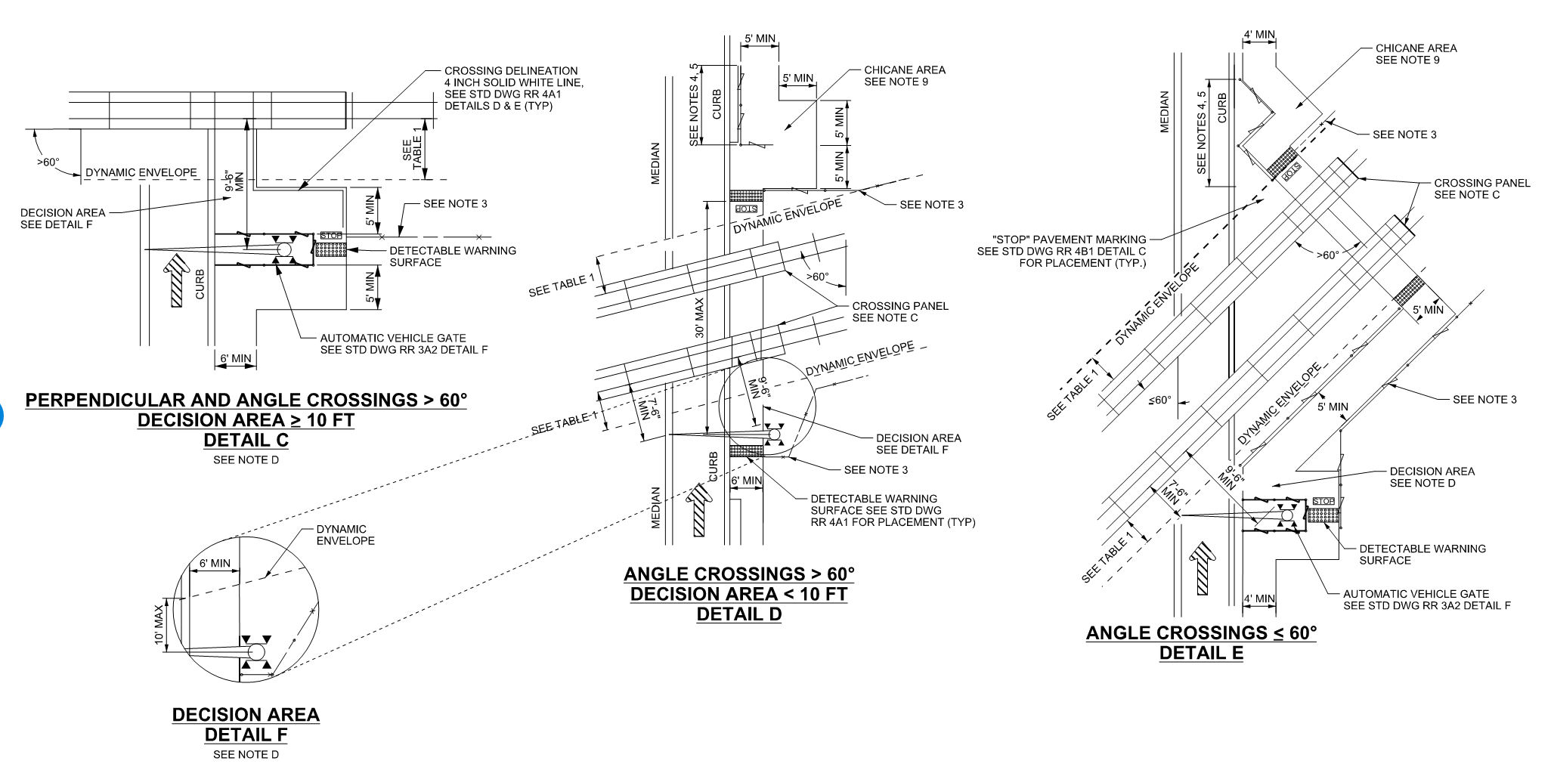
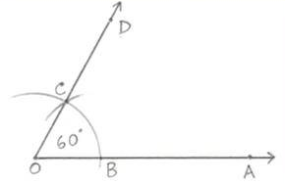
At-Grade Railroad Crossings
  Pedestrian Crossings
    Angles matter

Slide 40
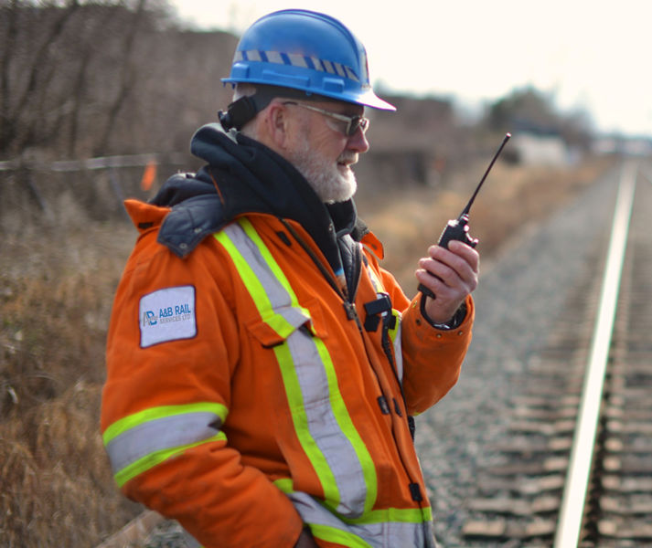
Flagger Protection/Observation
Freight = <25’ from track centerline, or the potential to foul
Relevant standards and resources:
  UP subcontracts to NRSS and RailPros https://www.up.com/real_estate/third-party-flagging/index.htm
RR flaggers only protect for rail, roadway flaggers are separate
Violations – FRA may asses civil fines $1,000 - $250,000
Observation – A construction observer is required when working above, under, or on railroad right of way.

Slide 41
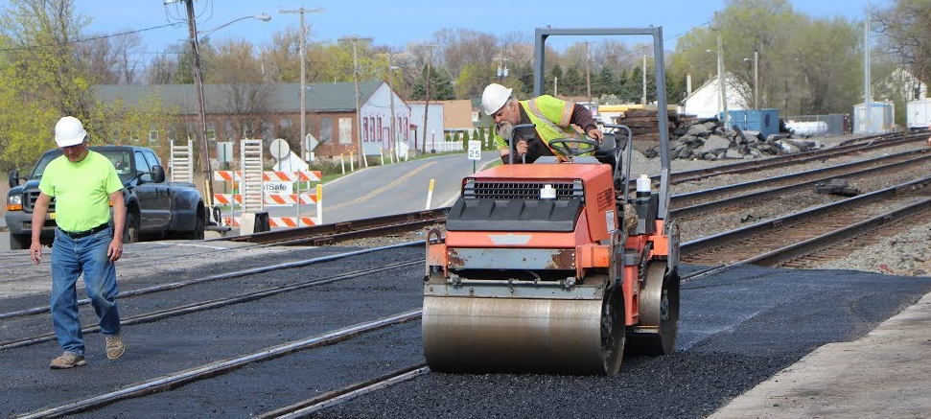
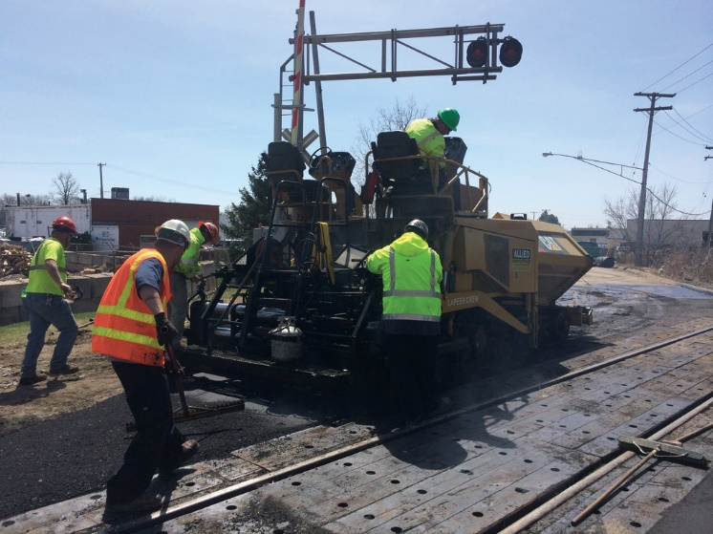
Right of Entry Permit
All RR’s require right of entry permits when you work on RR ROW
All RR’s require roadway worker protection (RWP) training
  UP – erailsafe https://www.up.com/aboutup/community/safety/erailsafe/index.htm
    Erailsafe can take 1-3 months to obtain
Process / timeline:
  1-4 weeks (non-intrusive)
  2-4 months (intrusive-geotech, potholing, etc.)
    Note: Potholing or excavation within 25' of centerline will automatically need
    secondary review (90-120 days)

Slide 42
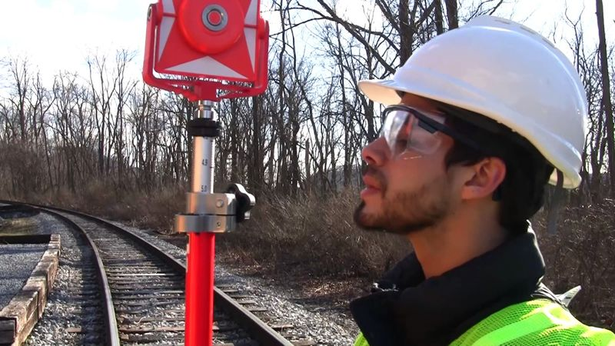
Right of Entry Permit
Relevant standards and resources:
  UP non-intrusive survey permit (no fees, no RPLI) https://www.up.com/cs/groups/public/@uprr/@realestate/documents/up_pdf_nativedocs/re_nonintrusive_survey_app.pdf
  UP intrusive permit ($1,000 - $5,000 fees + RPLI) https://www.up.com/real_estate/tempuse/index.htm

Slide 43
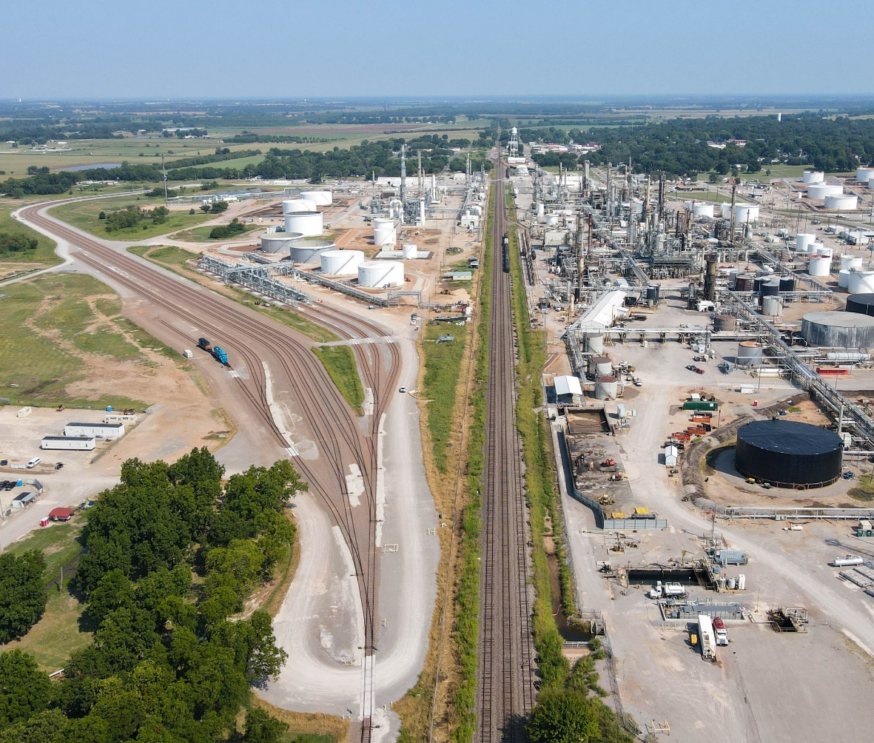
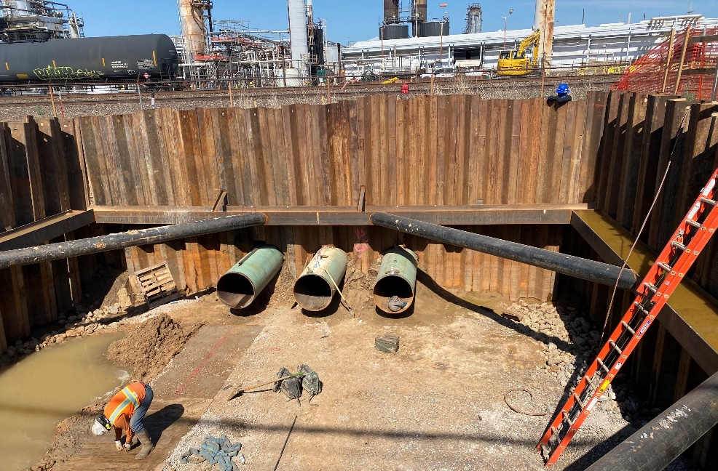
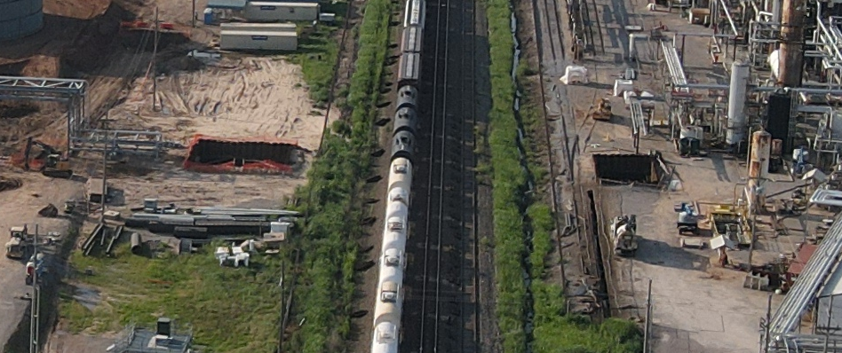
Utility Crossings and Encroachments

Slide 44
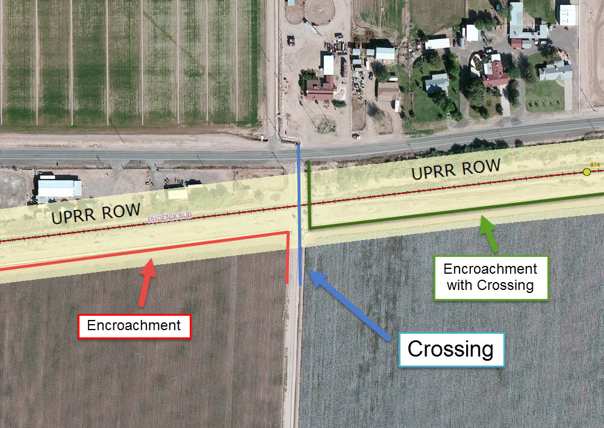
Utility Crossings and Encroachments
Crossing - Pipeline or wireline that crosses the RR ROW from one side to the other in as near a straight line as possible.
Encroachment - Pipeline or wireline that enters the RR ROW and either does not leave the ROW or follows along the ROW for some distance.

Slide 45
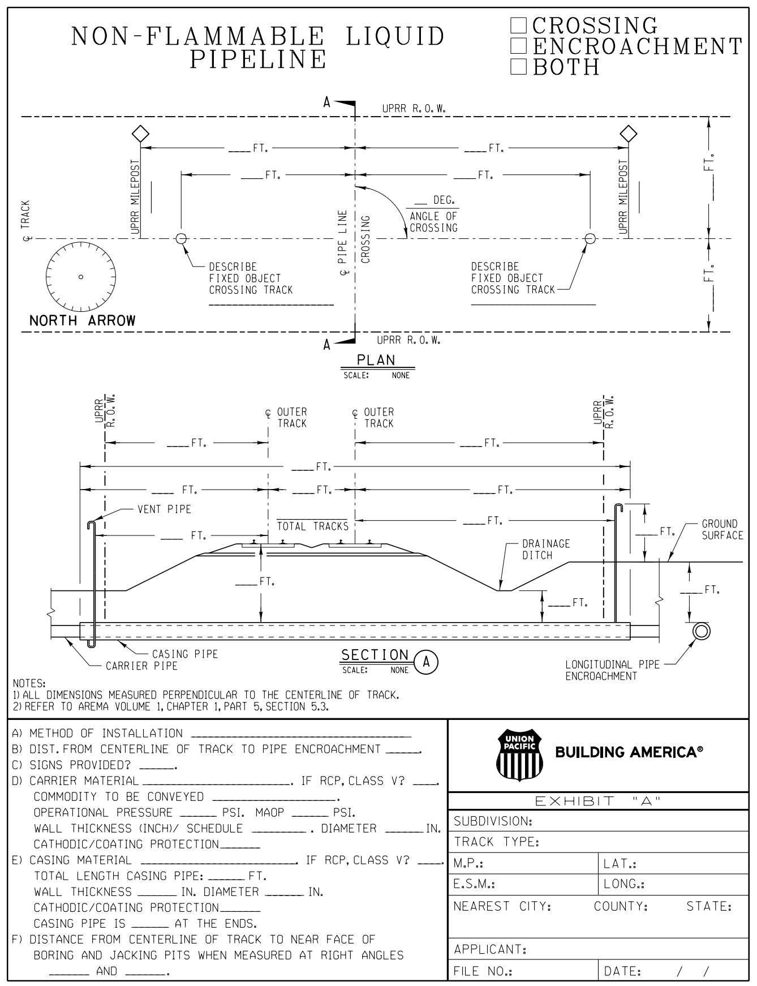
Utility Crossings and Encroachments
Wireline
  Underground Wireline Crossing 750V or Less
  Underground Wireline Crossing Over 750V
  Overhead Wireline Crossing 750V or Less
  Overhead Wireline Crossing over 750V
  Underground Wireline Encroachment
  Overhead Wireline Encroachment
Pipeline – flammable vs non-flammable
  Crossing Only
  Parallel Encroachment Only
  Crossing and Parallel Encroachment

Slide 46


Utility Crossings and Encroachments
Start Here (Submittal): Union Pacific Online Utility Application Portal https://www.uprr.com/rem/ucs/jas/#/home
Timelines after submittal
  Crossings meeting specs – 1-2 month review + 1 month agreement
  Encroachments meeting specs – 6 month review + 1 month agreement
  Variances to standard (Secondary Review) – additional 3-4 months
  Missing information – 1-2 month re-review
Costs
  Crossing application - $2,055
  5 business day rush fee - $12,055
  15 business day rush fee - $6,055
  Encroachment application - $4,055 (no rush fee available)
  Note: Rush fees are in addition to crossing application and are only applicable on the first, i.e total cost for a 5-business day rush is $14,110, if secondary review is needed, application will resume to normal timeline.

Slide 47

Utility Crossings and Encroachments
Relevant standards and resources:
  General wireline and pipeline crossing https://www.up.com/real_estate/utilities/index.htm
  Pipeline crossing https://www.up.com/real_estate/utilities/pipeline/pipeline_procedure/index.htm
  Pipeline specs https://www.up.com/real_estate/utilities/pipeline/pipespecs/index.htm
  Wireline crossings https://www.up.com/real_estate/utilities/wireline/wireline_procedure/index.htm
  Wireline specs https://www.up.com/real_estate/utilities/wireline/wirespecs/index.htm
  Wireline and Pipeline Encroachment Specifications https://www.up.com/real_estate/utilities/encroach_procedure/encroach_guide/index.htm

Slide 48
Utility Crossings and Encroachments
Relevant standards and resources:
  AREMA Manual for Railway Engineering ($1,000 - $1,500) https://publications.arema.org/Publication/MRE_2023
  Shoring requirements https://www.up.com/cs/groups/public/@uprr/@customers/@industrialdevelopment/@operationsspecs/@specifications/documents/up_pdf_nativedocs/pdf_up_str_temp-shoring.pdf
  Fixed object identity https://www.up.com/cs/groups/public/@uprr/@realestate/documents/up_pdf_nativedocs/pdf_up_reus_pipelinespec_track.pdf
  UP help contacts https://www.uprr.com/reus/contacts/mgrcontacts/index.cfm

Slide 49


Utility Crossings and Encroachments
Relevant standards and resources:
  UTA license agreements https://www.rideuta.com/doing-business/property-management
  AREMA Manual for Railway Engineering ($1,000 - $1,500) https://publications.arema.org/Publication/MRE_2023
Timeline after submittal
  8 weeks
Cost
  Application - $1,000 (unless for UDOT or city)
  Expedited review - $3,500

Slide 50
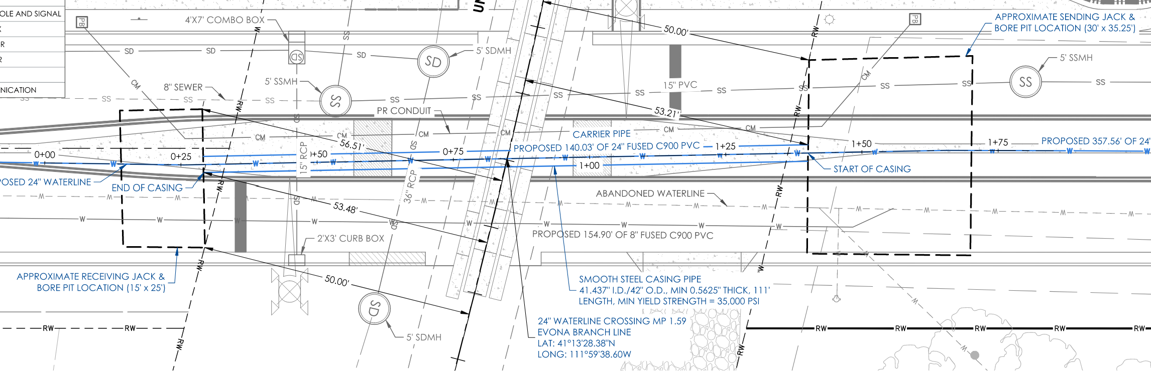
Utility Crossings and Encroachments
Plan View

Slide 51

Utility Crossings and Encroachments
Profile View

Slide 52
Utility Crossings and Encroachments
Noteworthy items from experience:
  Plan enough time at the beginning of the project
  Don’t bug the RR every week asking where it is at
  Stay out of shoring zone and show it on cross sections
  Keep structures at least 25’ away from rail CL
  Show ROW limits w/ dimensions to proposed modifications
  Over dimension everything in plan view (horizontal clearances to rail CL and ROW) and profile view (vertical clearances to top of tie and top of casing or bottom of wireline)
  Label RR MP and Subdivision
  NVE Energy submits utility crossings/encroachments internally

Slide 53
Q&A

Slide 54


Railroad Operations
Inbound train arrives heading
east

Slide 55

Railroad Operations
Leave inbound cars and pulls remaining cars past turnout

Slide 56

Railroad Operations
Detaches from cars, uses main to runaround to inbound cars

Slide 57

Railroad Operations
Uses main to runaround to inbound cars

Slide 58

Railroad Operations
Reconnects with inbound cars

Slide 59

Railroad Operations
Shoves inbound cars

Slide 60

Railroad Operations
Inbound cars are placed, locomotive detaches,
another train passes by

Slide 61

Railroad Operations
Pulls back past turnout, operator switches turnout

Slide 62

Railroad Operations
Attaches to outbound cars

Slide 63

Railroad Operations
Outbound cars
pulled onto siding

Slide 64

Railroad Operations
Locomotive reassembles
train

Slide 65

Railroad Operations
Locomotive detaches, uses
main to runaround

Slide 66

Railroad Operations
Locomotive detaches, uses
main to runaround

Slide 67

Railroad Operations
Shoves onto siding,
reassembles outbound train

Slide 68

Railroad Operations
Train departs

